Slide 1



PTP Holdover Feature
KDDI

Slide 2
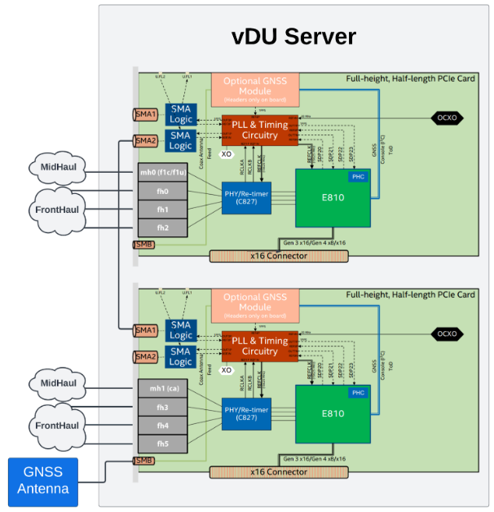
vDU Physical Network
Hardware : HPE DL110 Gen 11 / SPR-EE
Firmware version: 4.50
OCP version : 4.14.44
PTP Operator version : 4.14.0-202501021209

Slide 3
Current status
GNSS signal is Available and PTP state is “Locked”.
In case the offset value exceeds the threshold on the second NIC connected via SMA port,
the PTP status immediately changes from “Locked” to “Freerun”.
When It occurs, Service interruption happens with the connected RU devices due to unsynced time.
vDU
GNSS
NIC 1
RU
SMA1
RU
SMA2
RU
Disconnected due to unsynced time
spike
NIC 2
SMA1
RU
RU
SMA2
RU

Slide 4
What feature Samsung wants
PTP Holdover feature in case GNSS signal available.
Cause
Offset value exceeds the threshold(maxInSpecOffset)
It can occur any NIC interface.
Action – For example.
PTP status keeps “Holdover” during the current holdover period
or
Holdover within offset_spike_count_limit
When offset spike occurs the “offset_spike_count” increase 1.
If offset_spike_count_limit is bigger than offset_spike_count, the PTP status goes into “Holdover”
Resolution
When the offset is stable, PTP Status becomes Locked.

Slide 5
Thank you
Red Hat is the world’s leading provider of enterprise open source software solutions. Award-winning support, training, and consulting services make
Red Hat a trusted adviser to the Fortune 500.

